Slide 1
PRESENTED BY:
Agent Name
Email Address
Phone Number

Slide 2
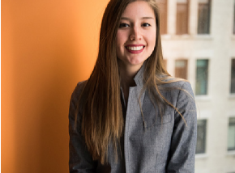
Stats
LISTING PRESENTATION
About me
$1.4M
Originally from Marco Island, Florida, Claren grew up in a family that worked in residential and commercial real estate sales.
Total Sales to Date
Claren Jokela
Agent Support
REALTOR®
DRE 12312312
727.742.5829
claren.jokela@daltonwade.com
clarenjokela.com
$1.4M
Transaction to Date
10
Years in Real Estate
After growing up in Florida with a family in residential real estate sales, Claren worked as a processor and closer at a title company for several years. This provided her with the unique experience she needed to make the transition into real estate sales. Claren knows that no matter the transaction or the price, everyone involved deserves to be treated with compassion and the utmost
professionalism. Let her help you locate your dream home or sell your existing home today! Since Claren is the spouse of an active duty military member, she thought it was very important to earn her certification as a Military Relocation Professional (MRP). If you or anyone you know is active duty or a veteran, she would be honored to help you buy or sell!
18%
Total Growth Year Over Year

Slide 3
My
philosophy
is simple:
clients
come
first

Slide 4
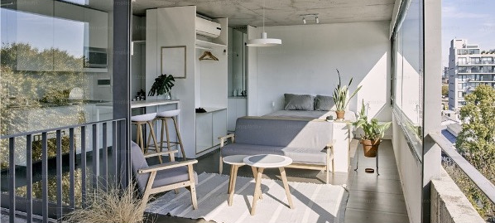
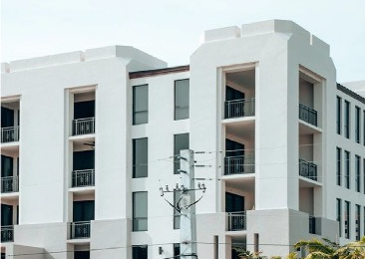
LISTING PRESENTATION
DALTON WADE
Sarasota Stats
All Sales, Under Agreement & Currently For Sale $400,000 - $500,000
169
109
612
Properties
on Market
Properties
Under Agreement
Sales in last
6 months

Slide 5
Why you
should
list
us?
your home with

Slide 6
LISTING PRESENTATION
DALTON WADE
Benefits of
working together
Recommended Property Pricing
Professional Photography
Staging Suggestions
For Sale Sign
Email Marketing To Buyer’s Brokers
Dalton Wade – “Social”
Dalton Wade – “Video”
Set Schedule of Open Houses
Coordination of Showings
Follow Up on All Showings
Feedback After Showings
Negotiation of All Offers
Negotiation of Home Inspection Issues
Review of ALTA Settlement Statement
Closing!

Slide 7
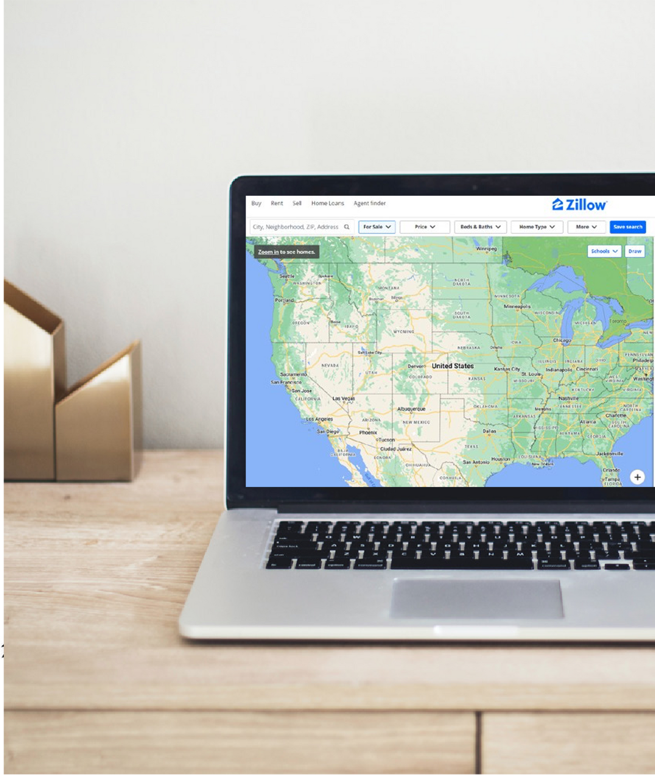
LISTING PRESENTATION
DALTON WADE
Internet
Marketing Campaign
98%
OF HOME
BUYERS SEARCH ON THE INTERNET
MLS – All Brokers and Agents
Will Have Access To Your Listing
Dalton Wade Internet Marketing Experts!
Via MLS Your listing will be distributed to all RE Brokerage Firms with an internet data exchange from the MLS
Popular Consumer Home Buying Web Sites
Where Your Listing Will Appear
Zillow, Trulia, Realtor.com, Homes.com,
& Many Others.
Listing and Listing Video w/voiceover will be on every web site with a data feed from MLS

Slide 8
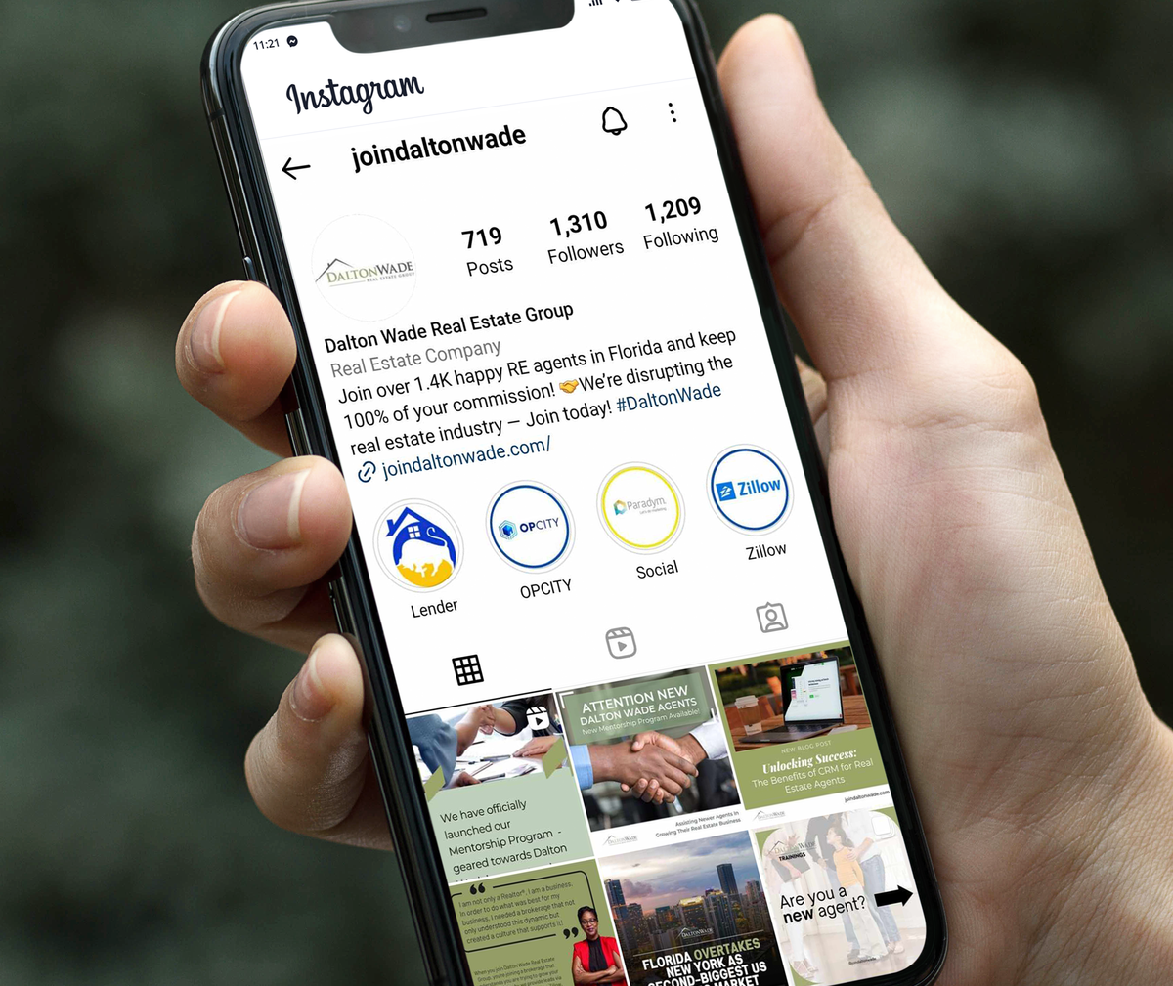
LISTING PRESENTATION
DALTON WADE
Social Media
Marketing Campaign
Real Estate thrives on personal connection sand many connections today are made via social media channels.
We will post your listing and listing video on all
my social channels.
Additionally, your listing and listing video will post on other Dalton Wade agents in your area social channels for further “Social Reach”.
FACEBOOK
TWITTER
PINTEREST
INSTAGRAM
LINKEDIN
YOU TUBE

Slide 9
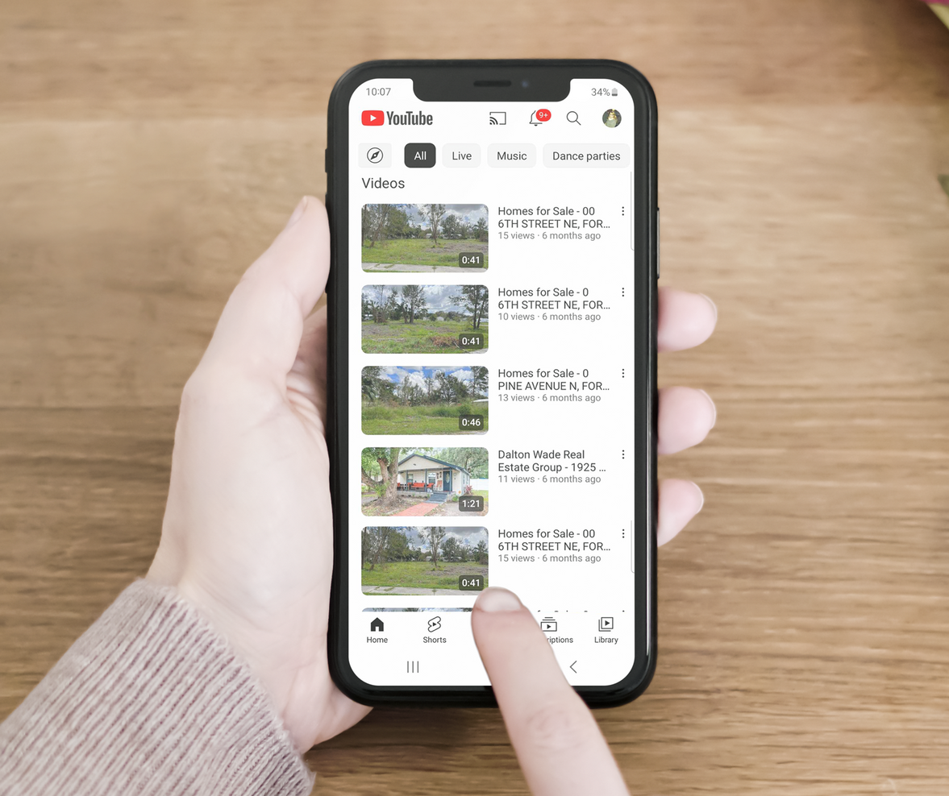
LISTING PRESENTATION
DALTON WADE
Dalton Wade - Video
Your listings will have a professionally done video complete with voice over plus:
Distributed to my Facebook, Linked In, Twitter,Instagram, Pinterest & YouTube
Pushed out to other Dalton Wade Agents in our area Social Channels
Branded format on the MLS Distribution network with in-video text & chat
Property Website
Property Flyer
Seller Reporting Stats

Slide 10
LISTING PRESENTATION
DALTON WADE
Open Houses
SCHEDULE OF OPEN HOUSES
WEEK 1
WEEK 2
WEEK 3
WEEK 4
WEEK 5
WEEK 6
All open houses are conducted
by either myself or by a Licensed
Dalton Wade Agent.

Slide 11
LISTING PRESENTATION
DALTON WADE
What does it cost?
5%
OF SALES PRICE
This is split 2% For Dalton Wade and 3% with the buyer’s agent or co-broker
3%
OF SALES PRICE
If I find a buyer directly (no co-broker). This happens in about 15% of Dalton Wade transactions.

Slide 12
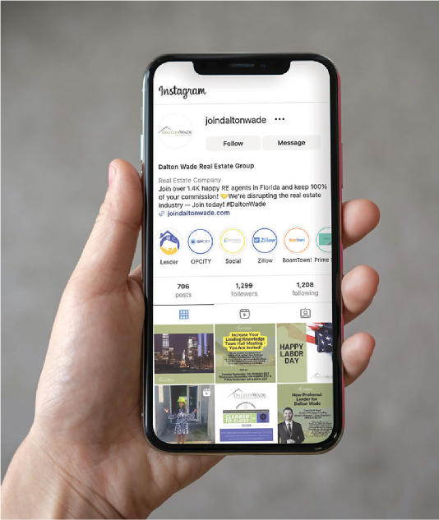
LISTING PRESENTATION
DALTON WADE
In Summary
Professional Photography
Aggressive Internet Marketing Campaign
on Top Sites (Realtor.com, Zillow and Trulia)
Strong Social Media Campaign
“Social” Use of Video to drive interest
Focus on Open Houses
Strong Follow up and Feedback Loop
Excellent Negotiator
Dalton Wade Agents sold over 6,000 homes in 2022

Slide 13
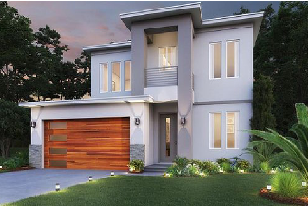
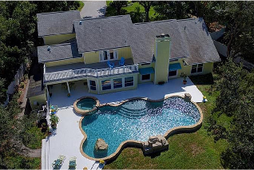
LISTING PRESENTATION
DALTON WADE
Client Testimonials
My Top Sales
“Claren is such an amazing person. Not only did she make our home buying experience wonderful but she still checks in with us often. I don’t know how we could have ever done it without her.”
— Buyer, Saint Petersburg FL
“I had a fantastic experience working with Claren. She is very professional and knows her field. Whenever we had question or request to see a property she responded quickly and readily available. She guided us throughout the whole process and made sure we were satisfied after closing. She helped us acquire two properties and I highly recommend her she provides a great levelof service and plan to work with her in the future. ”.
— Buyer, Saint Petersburg FL
4425 W Richardson Avenue
Tampa, FL
4 BD 3 BA 2,314 SF
$745,500
“I highly recommend Claren to anyone who is looking for a realtor. Claren went above and beyond for me during the buying process of a home. Providing excellent service throughout. ”.
— Annabel, Tampa FL
1493 75th Cir NE
Saint Petersburg, FL
5 BD 3 BA 4,012 SF
$2,264,500

Slide 14
Contact
www.daltonwade.com
phil@daltonwade.com
727.888.4175

